Slide 1
How to make
2 channel high voltage amplifier
Mar. 13th, 2020
Seongho Kim

Slide 2
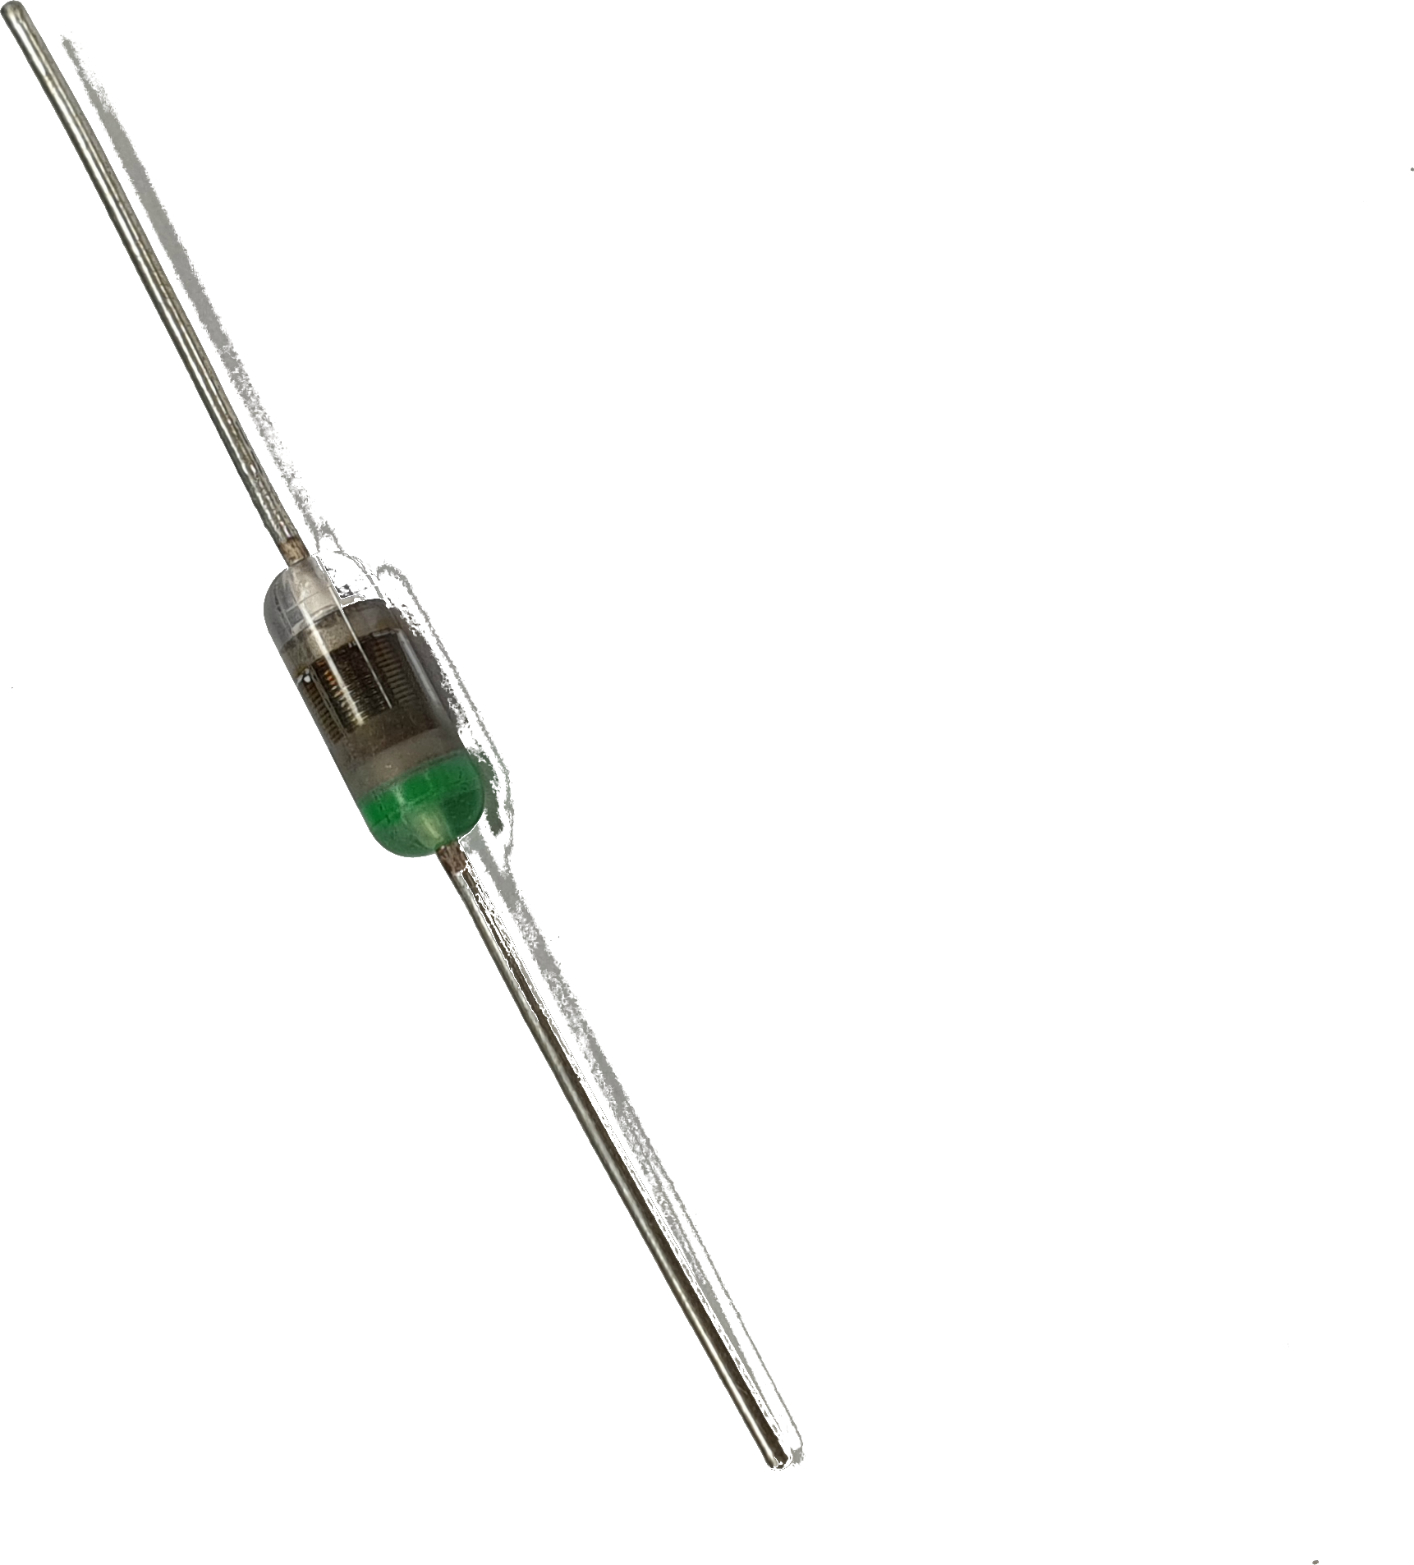
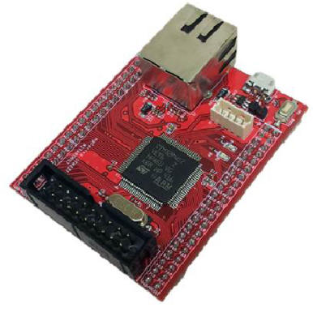
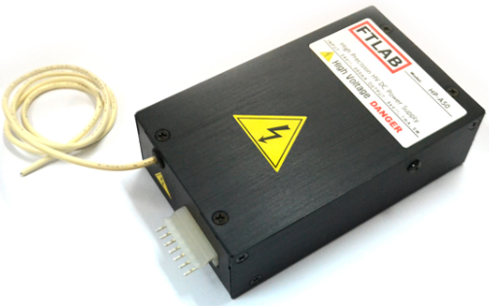
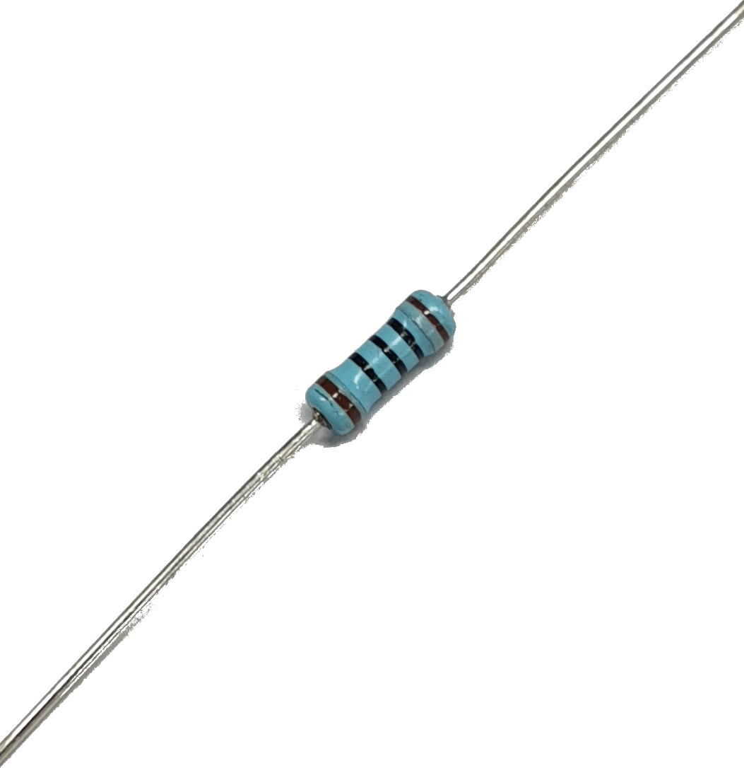
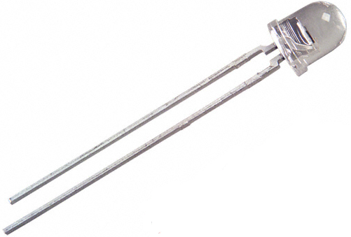
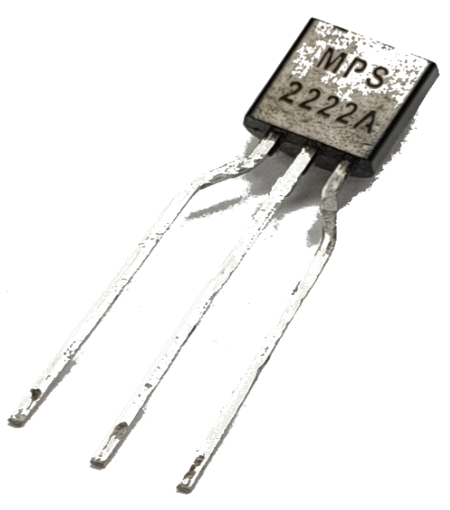
Main Components
Microcontroller
DCDC Converter
Opto Diode
Infrared LED
Transistor
100Ω Resistor

Slide 3
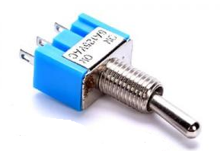
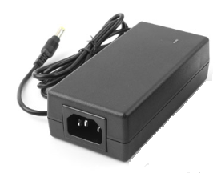
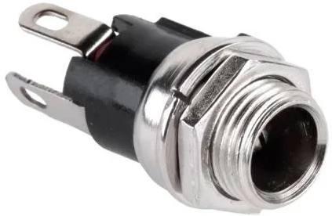
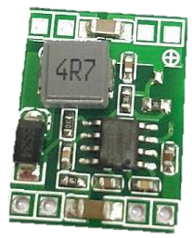
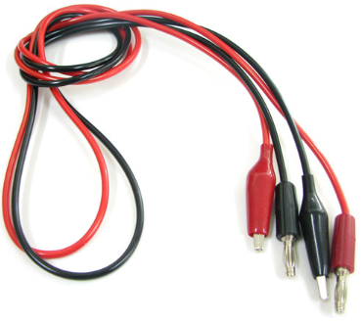
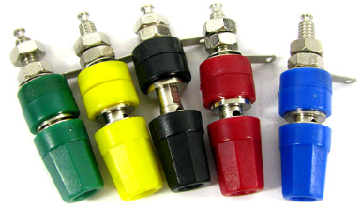
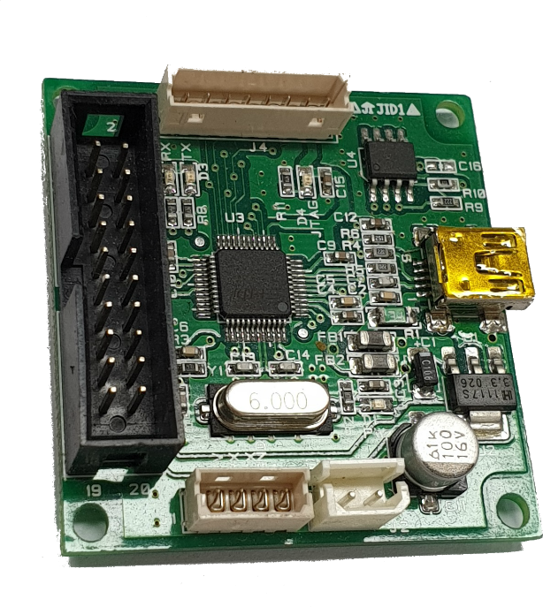
Other Components
Toggle switch
DC Power Jack
DC 24V 3A Adapter
DCDC Converter
(24V → 5V)
Crocodile Clip & Banana Connector
JTAG

Slide 4
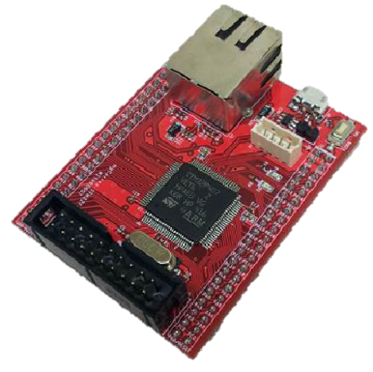
Main Components
Microcontroller
Microcontroller
DCDC Converter
Opto Diode
→ Microcontroller
It controls the low voltage circuit
Infrared LED
Transistor
100Ω Resistor

Slide 5
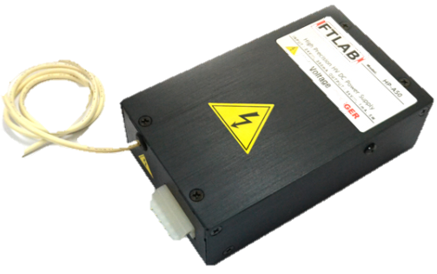
Main Components
Microcontroller
DCDC Converter
DCDC Converter
Opto Diode
→ DCDC Converter
It changes low voltage to high voltage
Infrared LED
Transistor
100Ω Resistor

Slide 6
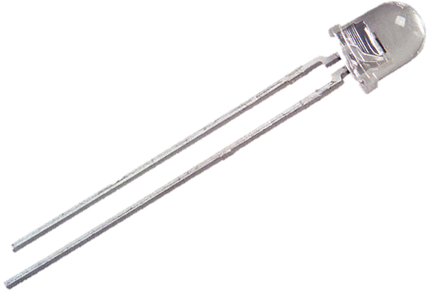
Main Components
→ Opto coupler = ( Opto diode + IR LED )
It is a device that transfers electrical signals between two
electrically isolated circuits through light energy.
If high voltage is applied to microcontroller,
it is out of order.
Microcontroller
DCDC Converter
Opto Diode
Opto Diode
So, It is used to divide circuit into low voltage circuit
and high voltage circuit.
Infrared LED
Infrared LED
Transistor
100Ω Resistor

Slide 7
Main Components
Microcontroller
DCDC Converter
Opto Diode
→ Transistor and Resistor
It is used to control the IR LED
Infrared LED
Transistor
100Ω Resistor
Transistor
100Ω Resistor

Slide 8
1Ch High Voltage Amplifier Circuit Diagram
5V
0V~3.3kV
(Output)
DCDC
Converter
24V
IR LED
GPIO
(Signal 1)
Opto diode
Low Voltage Circuit
High Voltage Circuit
Micro
controller
5V
DAC
GPIO
(Signal 2)
Actuator

Slide 9
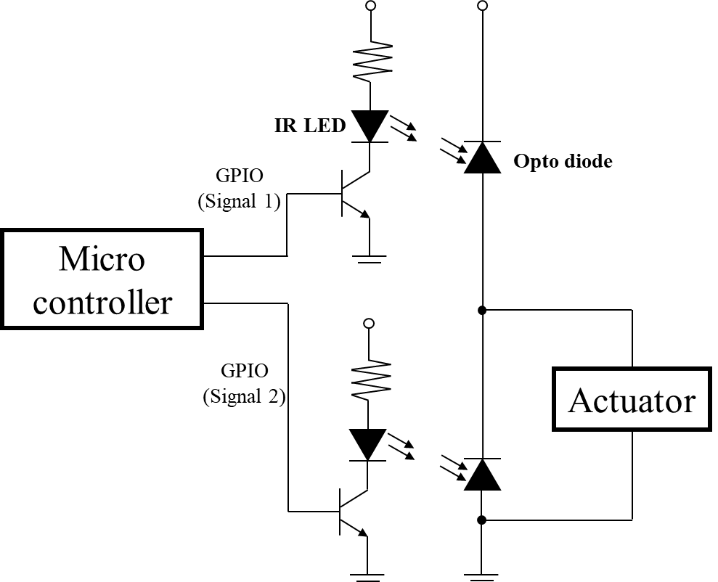
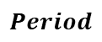
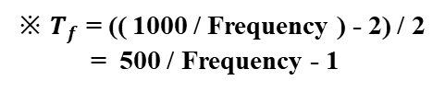
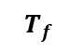
Signal control
※ $T_{f}$ = (( 1000 / Frequency ) - 2) / 2
= 500 / Frequency - 1
$$T_{f}$$
$$Period$$
Signal 1
OV
3.3V
OV
3.3V
OV
3.3V
Signal 2
3.3V
OV
3.3V
OV
3.3V
OV
Actuator
Off
On
Off
On
Off
On
1ms
Time

Slide 10
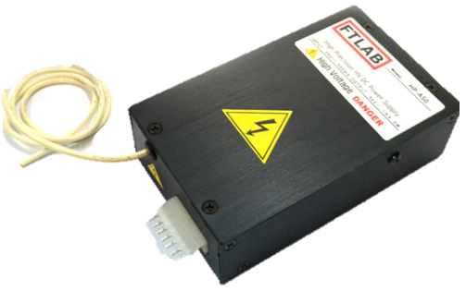
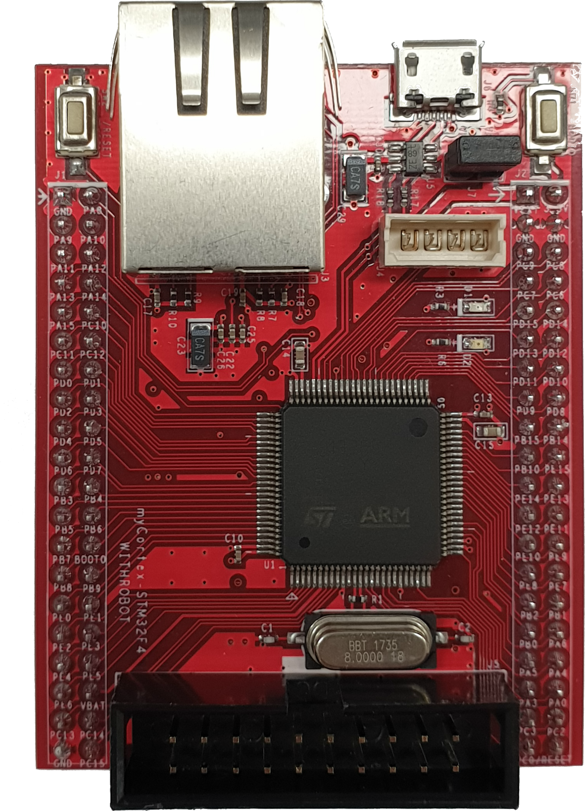
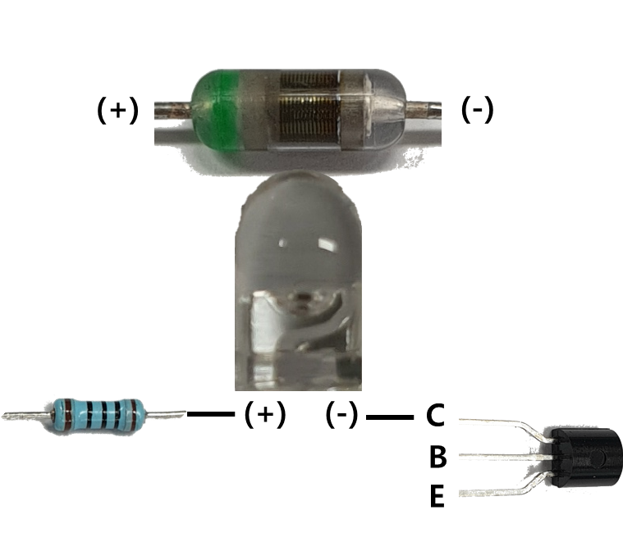
Making High Voltage Amplifier
Crocodile clip & Banana connector
L
H
Actuator
GND
: Ch1
: Ch2
: Signal(GPIO)
: DAC
1번
2번
Ch1 : D12 (1번), D14 (2번), DAC A4
Ch2 : D8 (1번), D10 (2번), DAC A5
< Ch 1 >

Slide 11
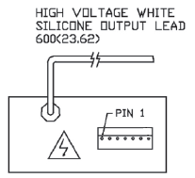
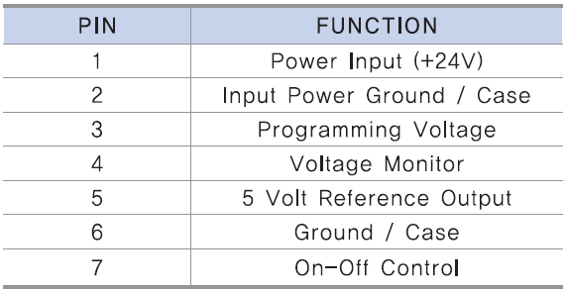
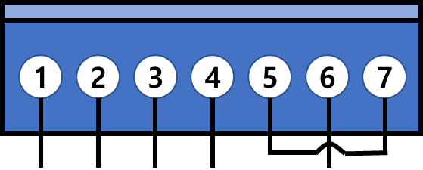
Making High Voltage Amplifier
24V
GND
DAC
Not use
GND

Slide 12
Making High Voltage Amplifier
GND
(-)
5V
24V
Off
On
L
24V
Not
use
On
GND
24V
(+)
24V
H

Slide 13
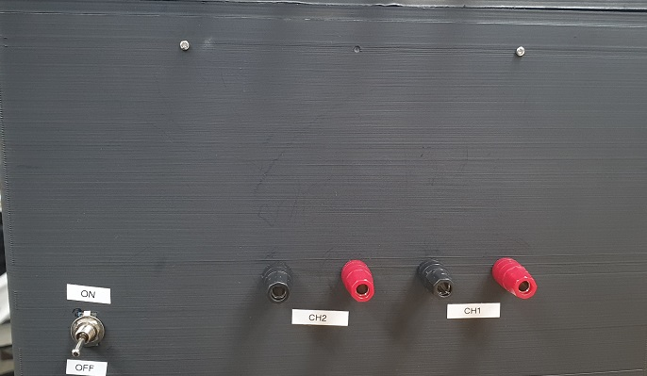
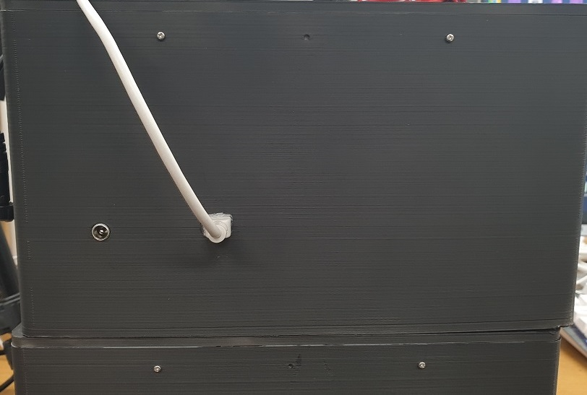
2Ch High Voltage Amplifier
< Front >
< Back >

Slide 14
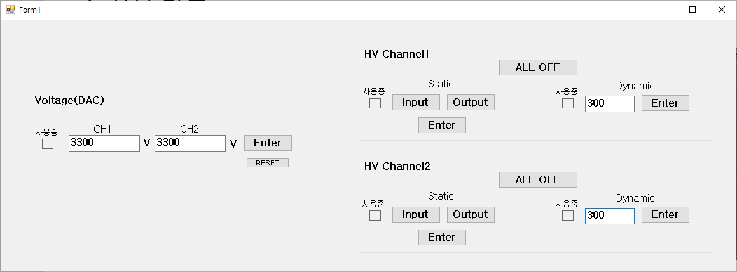
Program
※ Dynamic = 0~300 Hz
※ Voltage = 0~3300 V

Slide 15
Thank you

